Slide 1

Compiler Design
Preet Kanwal
Department of Computer Science & Engineering
Teaching Assistant : Kavya P K

Slide 2

Compiler Design
Unit 2
Predictive Parsers (LL(1))
Preet Kanwal
Department of Computer Science & Engineering

Slide 3
Compiler Design Lecture Overview
In this lecture, you will learn about -
What are Predictive Parsers?
Model of a Table-driven Parser
Computing First Sets
Computing Follow Sets
What is an LL(1) Parsing Table?
Construction of an LL(1) Parsing Table

Slide 4
Compiler Design
What are Predictive Parsers?
Predictive Parser is a table driven top-down parser without backtracking.
Class of grammars for which a table driven parser can be constructed is LL(k).
A predictive parser uses a lookahead pointer which points to the next input symbols.
It uses a stack and a parsing table to parse the input and produce a parse tree.
Both the stack and the input contains an end symbol $ to denote that the stack is empty and the input is consumed.

Slide 5
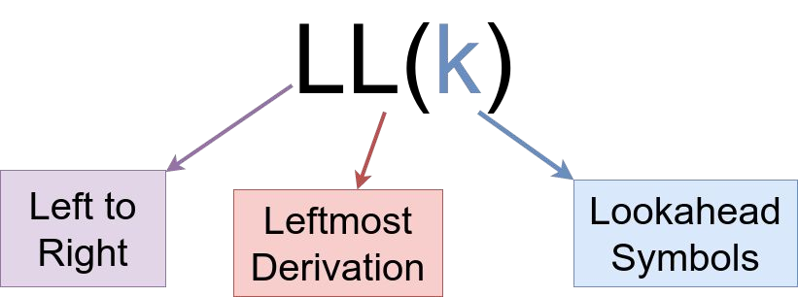
Compiler Design Predictive Parsers
Table driven parser can be constructed is for a class of grammars LL(k) where
The first L indicates that input is parsed from left to right.
The second L indicates that the output of the parser, which is a parse tree, is the leftmost derivation of the input string.
k denotes the number of symbols used for lookahead.

Slide 6
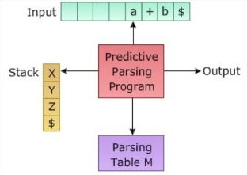
Compiler Design
Model of a table driven Parser

Slide 7
Compiler Design Computing First sets
The First() of a non-terminal is the set of symbols that appear as the first symbol in a string that derives from the non-terminal.
Rules to compute First set:
First(t) = { t }, where t is a terminal
If X -> λ, then add λ to First(X)
If X -> Y₁Y₂Y₃
First(X) = First(Y1)
If λ ∈ First(Y ), then First(X) = { First(Y ) - λ } U {
1 1
First(Y₂) }
If λ ∈ First(Y ) for all 1 ≤ i ≤ n, then add λ to First(X)
i

Slide 8
Compiler Design
Computing First set - Example 1
Consider the following grammar:
E | → | T E’
E’ | → | + T E’ | | | λ
T | → | F T’
T | → | * F T’ | | | λ
F
→ id | num | ( E )
Find the first set of non terminal T

Slide 9
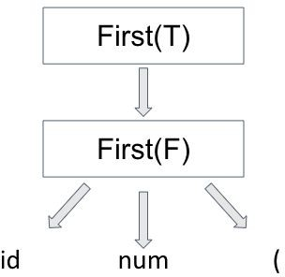
Compiler Design
Computing First set - Example 1
Production of T: T -> FT’
According to Rule 3, First(T) = { First(F) }
Consider all productions of F F -> id
F -> num F -> (
According to Rule 1, First(F) = { id, num, ( }
Since F does not have any λ productions, we stop here. Since First(T) = First(F),
First(T) = { id, num, ( }

Slide 10
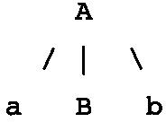
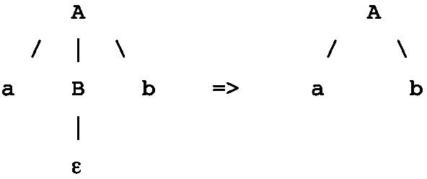
Compiler Design Follow Sets
Consider the partial parse tree on the right. Assume the following grammar:
A -> aBb B -> c | λ
When the input symbol is b, the non-terminal to derive is B. There is no production of B that starts with b, so the parser is now stuck.
However, if the lambda production of B, B -> λ, is applied, B vanishes and the parser parses ab correctly.
A non-terminal should vanish if the symbol that follows the non-terminal in the input is the same as the symbol that follows it in the production rule/in some sentential form.

Slide 11
Compiler Design Follow Sets
Thus, when there are nullable non-terminals in a grammar, there is a need to calculate follow sets of each of the nullable non-terminal so that their lambda productions can be used using parsing.
Follow(X) to be the set of terminals that can appear immediately to the right of Non-Terminal X in some sentential form.

Slide 12
Compiler Design Computing Follow Sets
Rules to compute Follow set:
Follow(S) = { $ }, where S is the start symbol
If A -> αBβ, where λ ∈ First(β), then Follow(B) = { First(β) - λ } U { Follow(A) }
If A -> αB, Follow(B) = Follow(A)
where α, β ∈ (V U T)*
V = Variables (non terminals) T = terminals
Note: Follow set should not contain λ

Slide 13
Compiler Design Follow Sets - Example 1
Consider the following grammar:
E | → | T E’
E’ | → | + T E’ | | | λ
T | → | F T’
T’ F | → → | * F T’ num | | | | λ id | ( E )
Compute the Follow sets grammar for each production.
of all non-terminals in the

Slide 14
Compiler Design
Follow Sets - Example 1 - Solution
E → TE’ | Follow(E) = $ Follow(T) = { + } ⋃ Follow(E) Follow(E’) = Follow(E)
E’ → + T E’/λ | Follow(T) = { + } ⋃ Follow(E’) Follow(E’) = Follow(E’)
T → F T’ | Follow(F) = { * } ⋃ Follow(T') Follow(T’) = Follow(T)
T’ → * F T’/λ | Follow(F) = { * } ⋃ Follow(T’) Follow(T’) = Follow(T')
F → ( E ) | Follow(E) = { ) }

Slide 15
Compiler Design
Steps to construct LL(1) Parsing Table
Eliminate Left recursion (if present) and Left factor the grammar(if required).
Calculate First() and Follow() sets for all non-terminals.
Draw a table where the first row contains the Non-Terminals and the first column contains the Terminal Symbols.
All the Null Productions of the Grammars will go under the elements of Follow(LHS).
Reason - The null production must be used only when the parser knows that the character that follows the LHS in the production rule is same as the current input character.

Slide 16
Compiler Design
Steps to construct LL(1) Parsing Table
For each production A –> α
For each terminal in First(α), make entry A –> α in the table.
If First(α) contains λ, then for each terminal in Follow(A) (i.e, Follow(LHS) ) make an entry A –> α in the table.
If the First(α) contains λ and Follow(A) contains $ as a terminal, then make an entry A –> α in the table under $.

Slide 17
Compiler Design
Constructing LL(1) Parsing Table - Example 1
Construct the parsing table for the earlier Grammar.
E | → | T E’
E’ | → | + T E’ | | | λ
T | → | F T’
T’ F | → → | * F T’ num | | | | λ id | ( E )

Slide 18
Compiler Design
Constructing LL(1) Parsing Table - Example 1
From the earlier examples, the first and follow tables for the given grammar is as follows -
First Table
E | E’ | T | T’ | F
id | + | id | * | id
num | λ | num | λ | num
( |  | ( |  | (
Follow Table
E | E’ | T | T’ | F
$ | $ | + | + | *
) | ) | $ | $ | +
 |  | ) | ) | $
 |  |  |  | )

Slide 19
Compiler Design
Constructing LL(1) Parsing Table - Example 1
Construct a table with terminals on the first row and Non-terminals on the first column.
 | id | + | * | num | ( | ) | $
E
E’
T
T’
F

Slide 20
Compiler Design
Constructing LL(1) Parsing Table - Example 1
For each production in the grammar, add appropriate locations.
entries to the
 | id | + | * | num | ( | ) | $
E | E -> TE’ |  |  | E -> TE’ | E -> TE’
E’
T
T’
F
E → TE’
Add the E → TE’ under each element in First(T)
First(T) = {id, num and ( }

Slide 21
Compiler Design
Constructing LL(1) Parsing Table - Example 1
For each production in the grammar, add entries to the appropriate locations.
E’ → + T E’ Add E’ → + T E’ under +
E’ → λ
So, Add E’ → λ under all elements in Follow(LHS), i.e,
{ ), $ }
 | id | + | * | num | ( | ) | $
E | E -> TE’ |  |  | E -> TE’ | E -> TE’
E’ |  | E’->+TE’ |  |  |  | E’ ->λ | E’ ->λ
T
T’
F

Slide 22
Compiler Design
Constructing LL(1) Parsing Table - Example 1
For each production in the grammar, add entries to the appropriate locations.
T -> FT’
Check First(F).
First(F)={id,num,(}
Add T -> FT’ under each element.
 | id | + | * | num | ( | ) | $
E | E -> TE’ |  |  | E -> TE’ | E -> TE’
E’ |  | E’->+TE’ |  |  |  | E’ ->λ | E’ ->λ
T | T -> FT’ |  |  | T -> FT’ | T -> FT’
T’
F

Slide 23
Compiler Design
Constructing LL(1) Parsing Table - Example 1
For each production in the grammar, add entries to the appropriate locations.
T’ → *FT’
Add T’ → *FT’ under *
T’ → λ
So add T’ → λ under all elements of Follow(T’) =
{+,),$}
 | id | + | * | num | ( | ) | $
E | E -> TE’ |  |  | E -> TE’ | E -> TE’
E’ |  | E’->+TE’ |  |  |  | E’ ->λ | E’ ->λ
T | T -> FT’ |  |  | T -> FT’ | T -> FT’
T’ |  | T’->λ | T’->*FT’ |  |  | T’->λ | T’->λ
F

Slide 24
Compiler Design
Constructing LL(1) Parsing Table - Example 1
For each production in the grammar, add entries to the appropriate locations.
F → num | id | (E) Add F → num under num
F → id
Add F → id under id
F → ( E )
Add F → (E) under (
 | id | + | * | num | ( | ) | $
E | E -> TE’ |  |  | E -> TE’ | E -> TE’
E’ |  | E’->+TE’ |  |  |  | E’ ->λ | E’ ->λ
T | T -> FT’ |  |  | T -> FT’ | T -> FT’
T’ |  | T’->λ | T’->*FT’ |  |  | T’->λ | T’->λ
F | F->id |  |  | F->num | F->(E)

Slide 25
Compiler Design
Constructing LL(1) Parsing Table - Example 1
Thus, this is the final LL(1) parsing table for the given grammar.
 | id | + | * | num | ( | ) | $
E | E -> TE’ |  |  | E -> TE’ | E -> TE’
E’ |  | E’->+TE’ |  |  |  | E’ ->λ | E’ ->λ
T | T -> FT’ |  |  | T -> FT’ | T -> FT’
T’ |  | T’->λ | T’->*FT’ |  |  | T’->λ | T’->λ
F | F->id |  |  | F->num | F->(E)

Slide 26
Compiler Design
LL(1) Parsing Table - Conclusions
The LL(1) parsing table can now be used to parse an input string. This will be demonstrated in the next class.
To check whether a grammar belongs to LL(1), check whether each box in the LL(1) parser table has atmost 1 production.
If a grammar is not Left Factored, or Left Recursion is not removed, it will not belong to LL(1).
The first table will never contain $
The follow table will never contain λ

Slide 27
THANK YOU
Preet Kanwal
Department of Computer Science & Engineering
preetkanwal@pes.edu

